Slide 1
Blackjack
Military Space Pivot to LEO
Mr. Paul “Rusty” Thomas, Program Manager
DARPA Tactical Technology Office
Briefing prepared for Future In-Space Operations Telecon
August 22, 2018

Slide 2
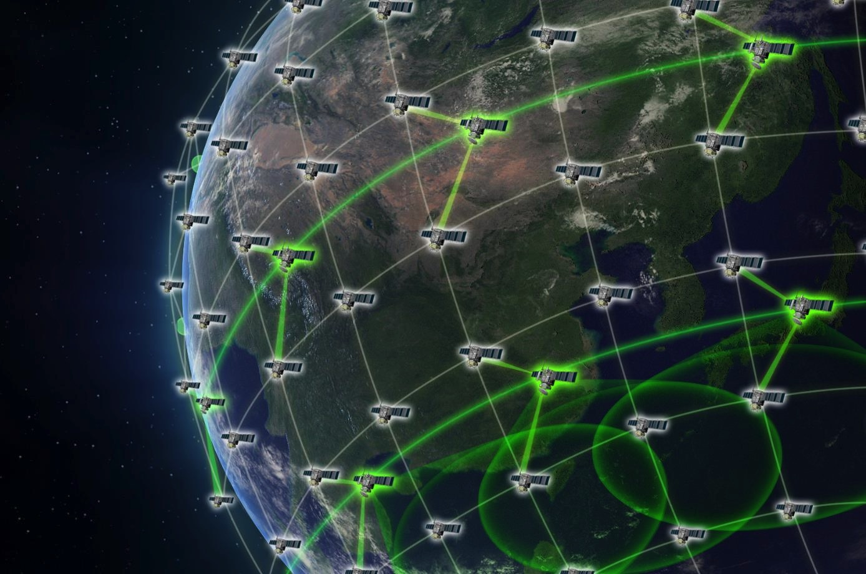


Military Space - Pivot to Low Earth Orbit (LEO)
Demonstrate a space order of battle architecture that cannot be easily defeated by a near peer, and enables one to two year technology refresh cycles vs current 10 year cycles.
LEVERAGE:
Commercial LEO
Mega-Constellation
Global “Space Internet”
High-speed crosslinks
Launch, operations,
and ground
infrastructure in place
Commercial
Network
Satellite
Military
Satellite
DEVELOP:
Co-Orbiting Military
Demo Constellation
Rapid tech refresh
Resilience
Global persistence
Autonomous ops
Overhead Persistent Infrared (OPIR) Position Navigation Timing (PNT) Communication (RF)
Low-cost commoditized COTS bus
Rapid response to future threats
Artist’s Concept

Slide 3
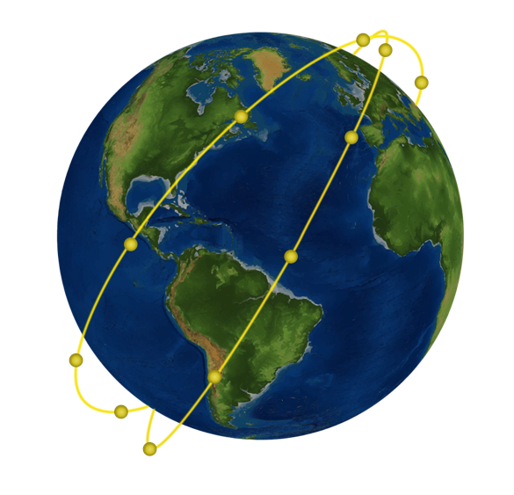
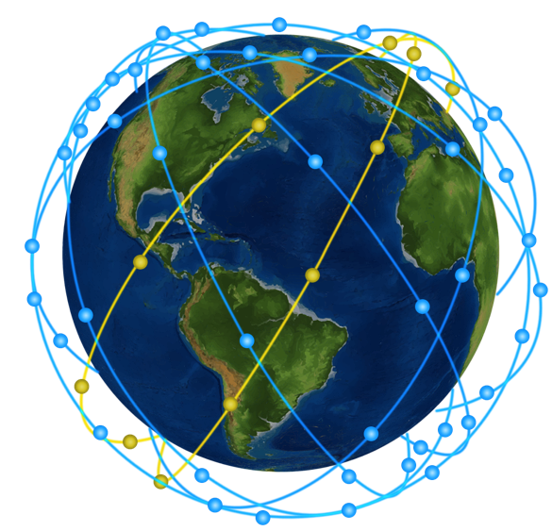
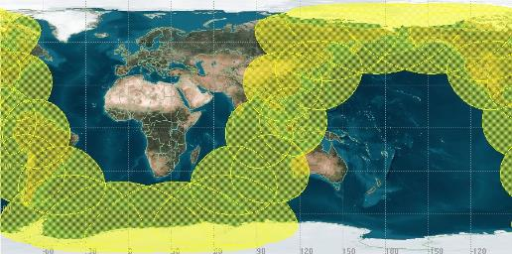
20 LEO Autonomous Spacecraft Demonstration
20-Spacecraft Demonstration
2 planes x 10 sats/plane at 1000 km
(2 s/c initially plus 18 add’l for full demo)
90-Spacecraft Objective System
9 planes x 10 sats/plane
(not part of Blackjack program)
  Demonstrate:
  Persistence – spacecraft handoff
  Autonomy
  Network / crosslinks
  On-board processing
  Stereo sensing
  Global Command, Control, Commun- ications (C3)
  Commercial Production Line Approach
Notional orbits/inclination
Notional
Coverage footprint would enable simultaneous theater-level demos
Global coverage
Commercial launch capability to launch 2 military S/C per week
Full system could launch in 2022

Slide 4
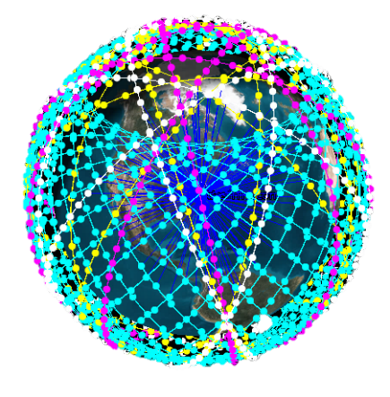
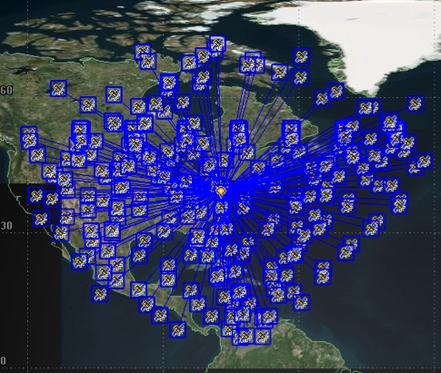


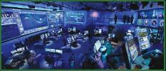
Commercial Mega-Constellation in LEO for Global “Space Internet”
Concepts with hundreds to thousands of LEO comm satellites
Commercial LEO
Mega-Constellations
200+ Satellites in View
From Single Ground Point
(0 degree grazing angle shown)
(45 degree grazing angle=10+ satellites in view)
1
Commoditized Bus
2
Inter-satellite Links
Frequent
launches
4
Constellation management
3
Leverage Commercial Investment
1-3 wks
1-3 wks
…
…
…
20+
s/c
20+
s/c
20+
s/c
…
Unprecedented low cost: Bus: $1M-5M; Payload: $1M-5M; Launch: $2M-5M
2021 demo (planned): 20 autonomous spacecraft in 2 orbital planes for theater-level ops

Slide 5
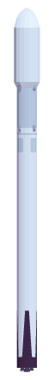
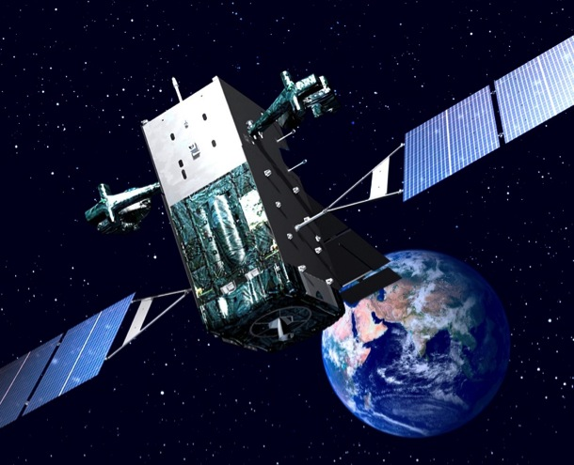
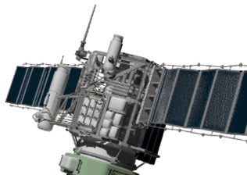

Cost Objective: Blackjack
Cost of Notional LEO
OPIR Constellation
Cost of One SBIRS GEO
Spacecraft + Launch: $1.2B
= $270M
Std Bus: $1M x 90
Launch: $3M/satellite x 90
= $90M
Payload: $2M x 90
= $180M
CONSTELLATION COST
$540M
Military Benefits
Resilience
Deterrence
Rapid tech refresh
Global persistence
Scalable
Tactical timelines

Slide 6
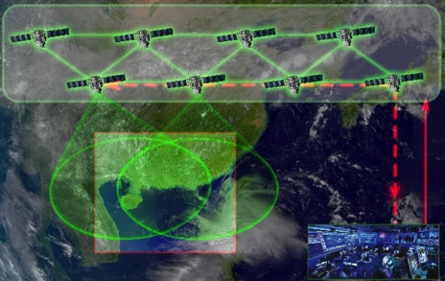
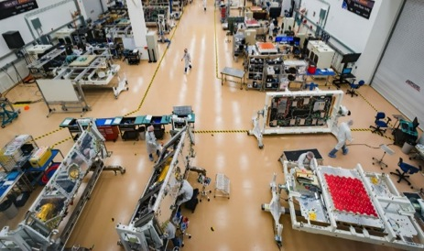
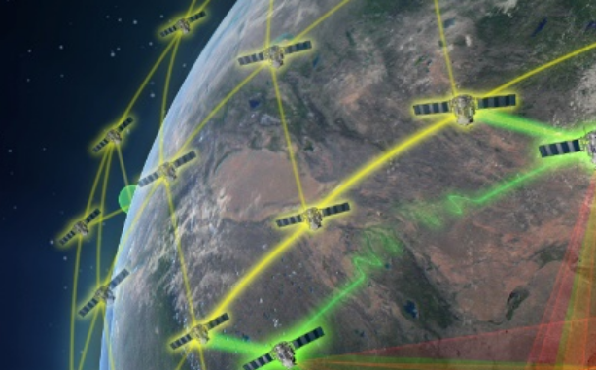
Program Technology Challenges
    Demonstrate payload autonomy
        Auto Target Recognition and geolocation
        Tactical- and operational-level direct prioritization
    Demonstrate multi-theater mission autonomy
        Develop human-on-the-loop verification schemes for space C3ISR
    Demonstrate DoD can maintain commercial pace
    Flight readiness to LEO operations in weeks
      Annual tech refresh cycle
    Interface Control Document (ICD) to manage commercial configurations
    Demonstrate capability of OPIR/PNT/RF systems to augment NSS systems without exquisite payload cost and schedule
    Prove pivot to LEO as optimal architecture to expand NSS capabilities and quickly respond to new threats
Autonomy and
On-Orbit Decisions
Payload Manufacturing Technology
LEO Constellation Performance
Artist’s Concept

Slide 7
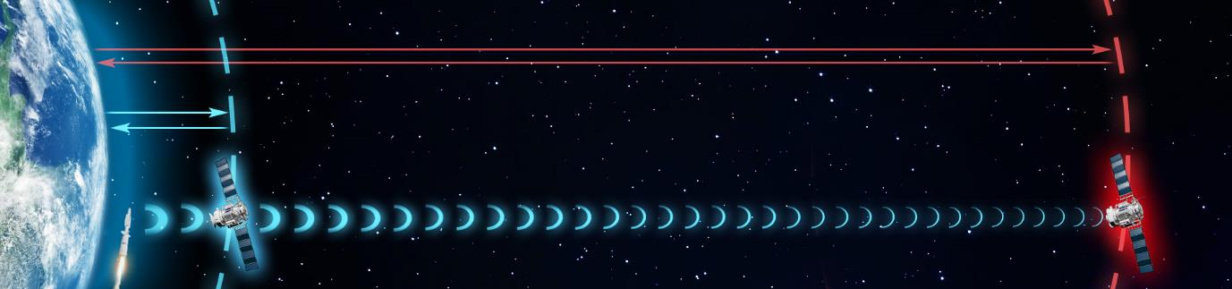
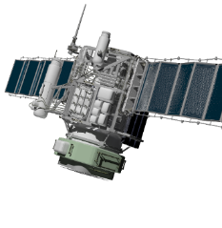
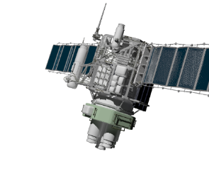
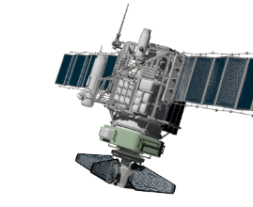
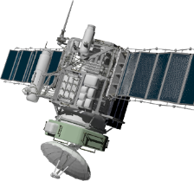
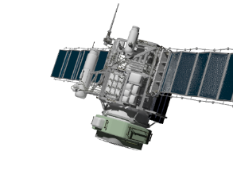
LEO Mission Payload Advantages
LEO
478 ms
GEO
14 ms
Signal: +31dB vs GEO
Signal: weak
Launch: ~$5,000/kg
Launch: ~$30,000/kg
Signal strength at LEO is 1280x stronger than at geosynchronous orbit (GEO)
Low latency in LEO improves tactical timelines
Persistence via proliferation across LEO constellation – continuous coverage
Mission | OPIR | PNT | Comm | RF | Radar
LEO Impact (Envisioned) | Augment missile warning/defense | Augment GPS | Global comm/ tactical timelines | Increased signal strength | Global coverage
COTS
BUS
P/L

Slide 8
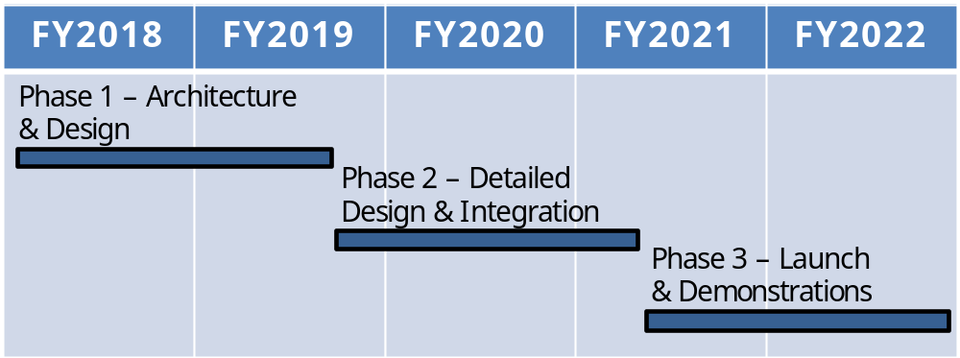
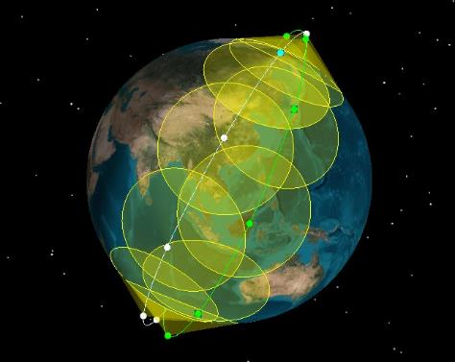

Blackjack Schedule
Notional orbits/inclination
20-satellite demonstration
Demo coverage footprint for 2 planes,
10 satellites/plane, 1000 km

